Slide 1

Cyclistic Bike-Share
annual members vs casual riders
-Kyle Burns

Slide 2
How do annual members and casual riders use Cyclistic differently?
Seasonally? In sheer numbers? Popular days of the week? A BRIEF overview through excel and R.

Slide 3
The Data – Pulled the previous 12 months of trip data. Original CSV files converted to XLS files for cleaning and manipulation.
Bike Usage by seasons. Look for trends in riding amongst each group.

Slide 4
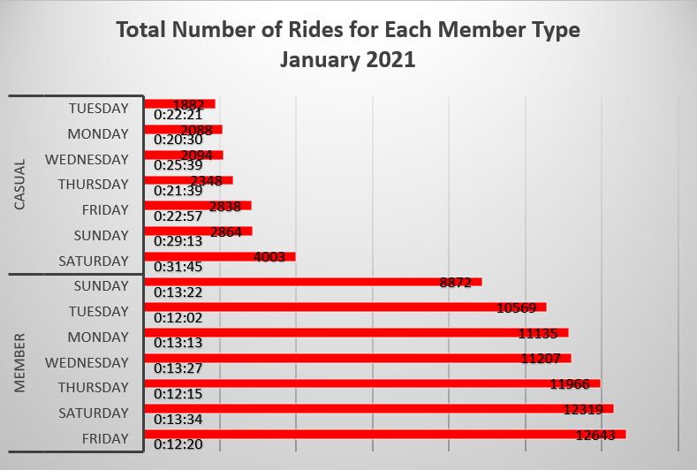
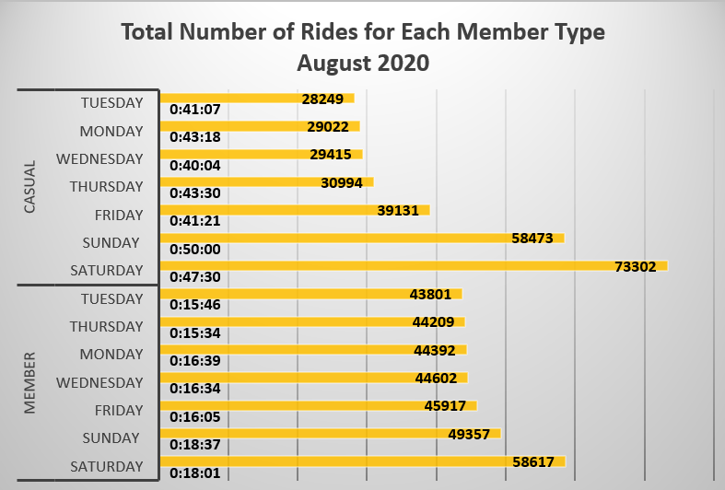
Bike Usage by Season
We see a drastic increase in casual riders for the summer months.
See the side-by-side comparison of January and August.
Causal riders (7-day average)
August – 41,227
January – 2,588
Member riders (7-day average)
August – 47,271
January – 11,244

Slide 5
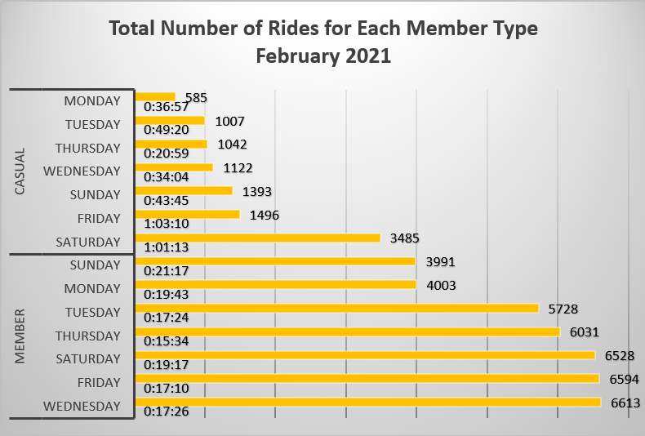
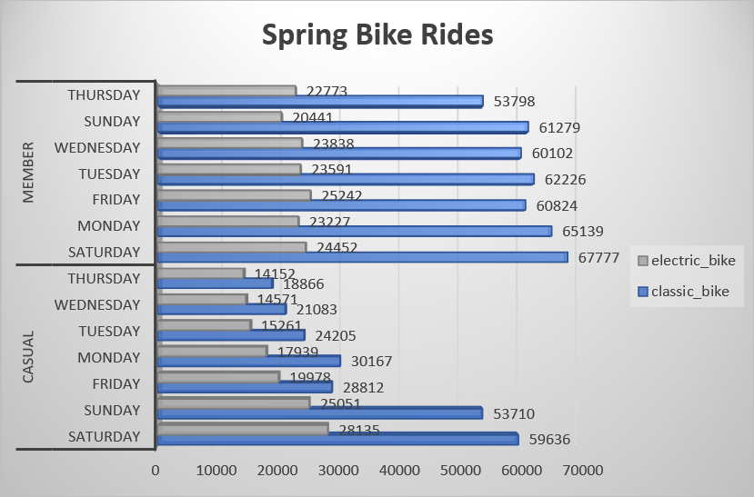
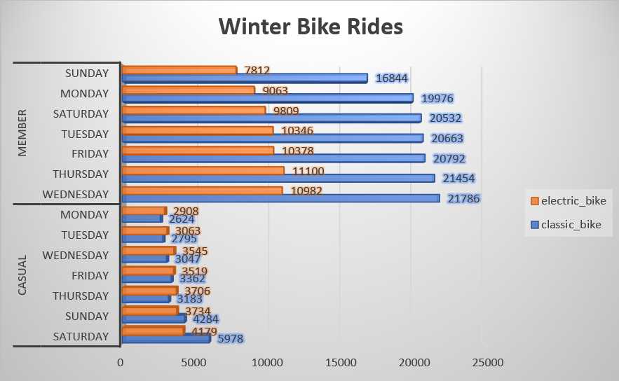
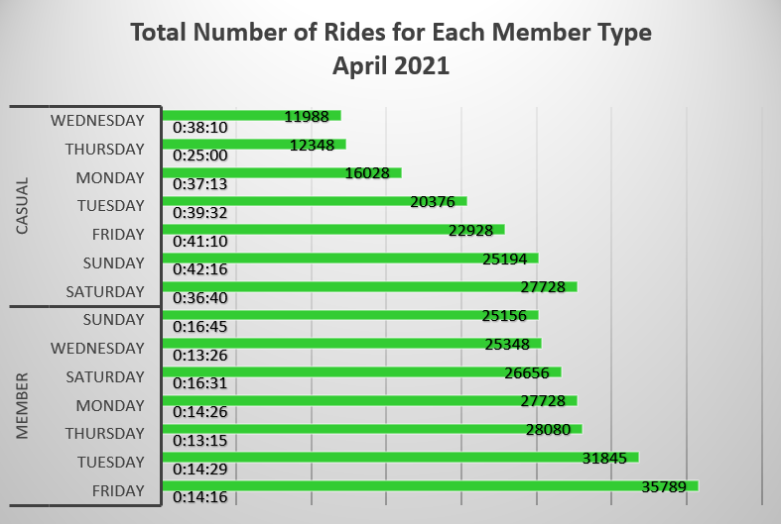
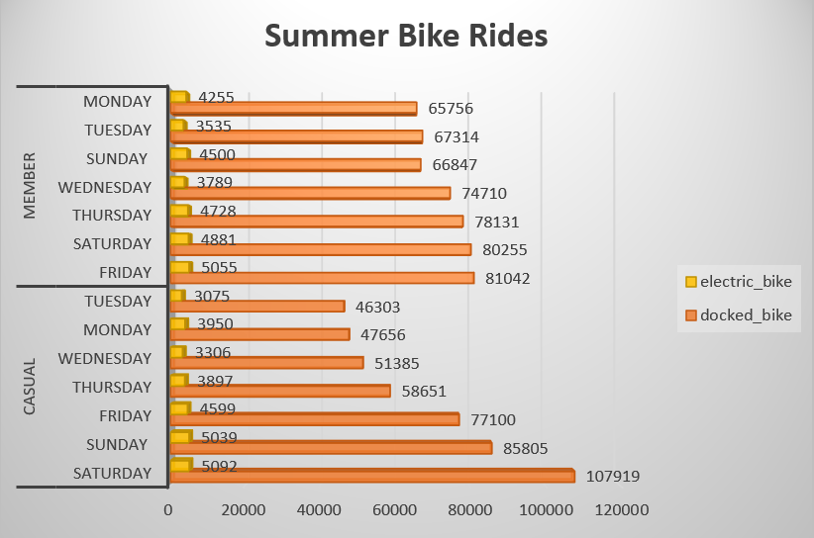
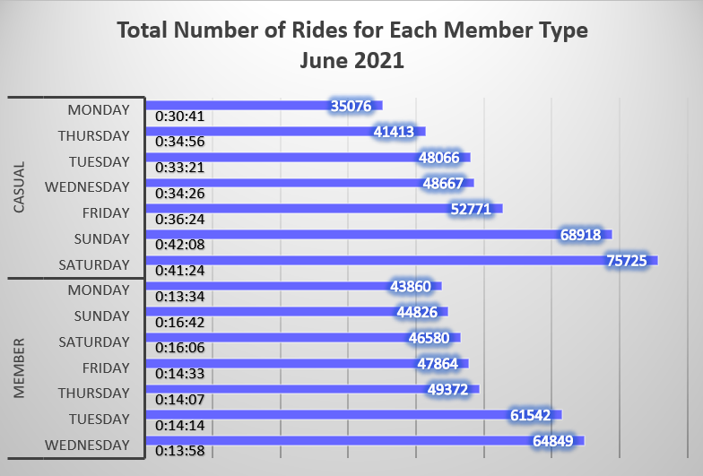
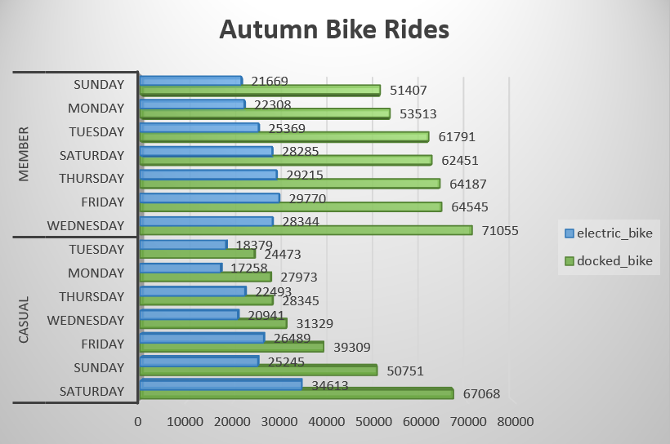
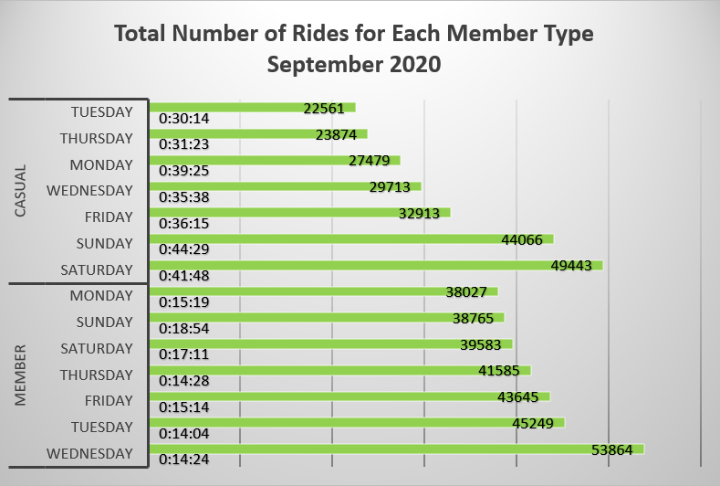
Look for trends in riding amongst each group.
SPRING
WINTER
Most popular days amongst each rider type:
Members – weekdays
Casual riders – weekends
Most member riders seem to skew towards a work commute demographic. (average rides of around 15 min)
Whereas most casual riders seem to enjoy the bikes for recreation. (average ride times of over 30 min)
SUMMER
AUTUMN

Slide 6
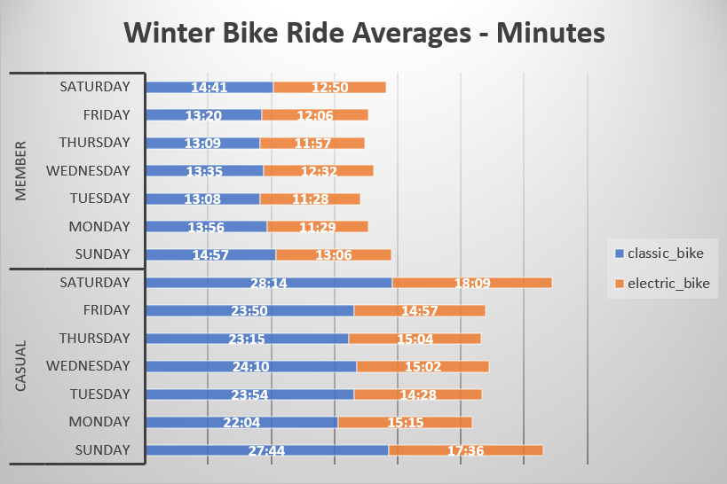
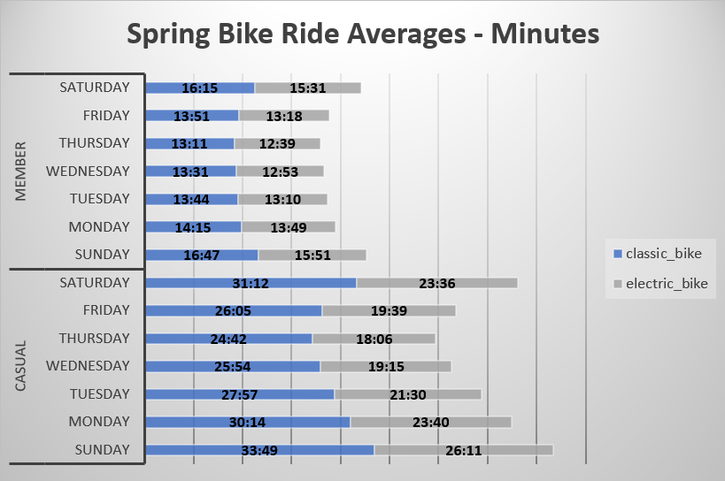
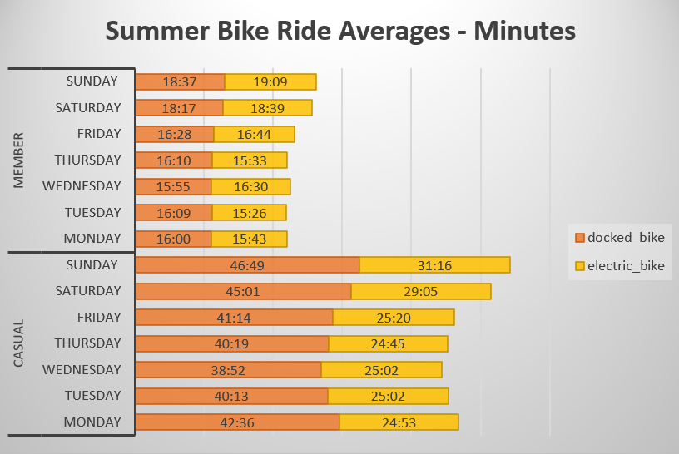
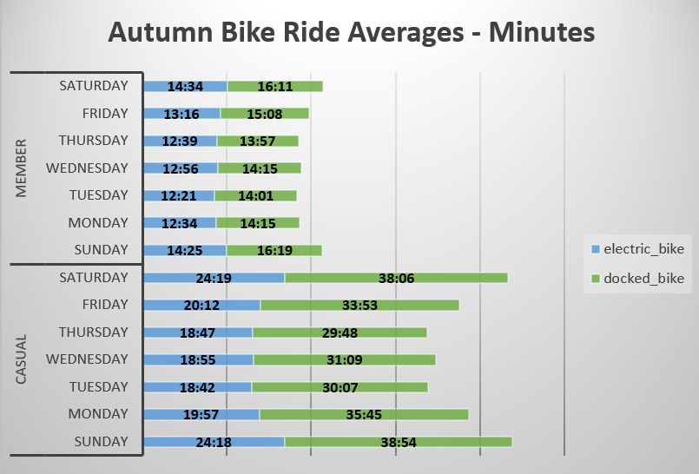
Look for trends in riding amongst each group continued.
SPRING
WINTER
Most popular bike type = Docked/Classic Bike
We see an uptick in electric bike usage in the colder months. (especially among casual riders)
There is also a correlation with an increased number of rides and the average amount of time spent on the bike.
The better the weather, the more rides and the longer the duration.
SUMMER
AUTUMN

Slide 7
Main takeaways:
Casual riders:
More likely to ride during the weekends with good weather.
Ride for more than 40 minutes.
More likely to use electric bikes in the colder months.
Member riders:
More consistent in their riding.
Use bikes to commute less than 20 minutes.
More likely to use a classic or docked bike.
Based on the cleaned and sorted data in Excel.
Compiled monthly data into seasonal data using R.

Slide 8
Recommendations
Offer a new flex membership: ride classic bikes in the summer and electric bikes the other three seasons.
During the summer, have a bigger selection of classic and docked bikes available. (August total rides – 619,481 vs December total rides – 131,133).
During the colder months (spring, fall, and winter), offer more electric bikes.
Offer a discount on electrical bikes in the summer.
- Kyle Burns

